Slide 1
Week 5–6
Baseline_v2 CNN Model
Bone Fracture Detection & SOTAs
ResNet-18 · FracAtlas · Explainability · SOTA Comparison
65.81%
88.75%
64.66%
88.84%
F1 Score
Accuracy
Recall
AUC
W3-4 E3 Baseline (Test): Acc 79.2% | Recall 77.0% | Precision 46.1% | F1 57.7% | AUC 0.857 → Overfitting gap 0.27
MSc. Explainability & Reliability in Medical AI | March 2026

Slide 2
Previous Work Recap — Weeks 1–4
Building the Foundation
Wk 1–2
Wk 3–4
Wk 4 Feedback
Dataset & Literature
E3 Baseline Model
Supervisor Directives
Selected FracAtlas (4,083 X-rays, 717 fractured)
Class imbalance: 4.69:1 (Non-frac dominant)
Reviewed SOTA: YOLOv8, InceptionV3+BAM, EfficientNet
Defined primary metric: F1 on Fractured class
ResNet-18 full fine-tune, CE loss × class weight 4.69:1
Threshold: 0.5 (default)
Result: F1=57.7% | Recall=77% | Acc=79.2% | AUC=0.857
Issue: High recall but low precision → poor F1
Maximise F1 (not recall alone)
Reduce overfitting gap (Train=0.08 vs Val=0.35)
Explore weight rebalancing, dropout, LR scheduling
Apply GradCAM as first XAI check
SOTA Checks based on FracAtlas
E3 Baseline (Test): Acc 79.2% | Recall 77.0% | Precision 46.1% | F1 57.7% | AUC 0.857 → Overfitting gap 0.27
MSc. Explainability & Reliability in Medical AI | Week 5–6 | March 2026

Slide 3
Week 5–6 Objectives
01
02
03
Improve F1 Score & TTA
Reduce Overfitting
Optimize Threshold Knob + TTA
Beat E3 baseline of F1=57.7% through systematic experimentation. F1 was designated primary metric by supervisor — balancing precision and recall on imbalanced data
Address train/val loss gap of 0.27 (E3). Target gap <0.15 through dropout regularisation and better LR scheduling.
Default threshold of 0.5 is suboptimal on imbalanced data. Sweep thresholds on validation set to find the F1-maximising operating point + Test Time Augmentations Trials
04
05
06
Explore LR Scheduling
Test Focal Loss
First XAI: GradCAM
Test cosine annealing with warmup to stabilise training vs ReduceLROnPlateau. Warmup prevents early high-LR instability.
Lin et al. (2017) focal loss dynamically downweights easy negatives. Hypothesis: better minority class focus vs fixed class weights.
Apply Gradient-weighted Class Activation Maps to verify the model attends to bone regions, not background artefacts. Gate: F1 ≥ 0.60.
MSc. Explainability & Reliability in Medical AI | Week 5–6 | March 2026

Slide 4
Experiment Results
E4a → E4i → E4e → E4h → E4g2 → Final Test
MSc. Explainability & Reliability in Medical AI | Week 5–6 | March 2026

Slide 5
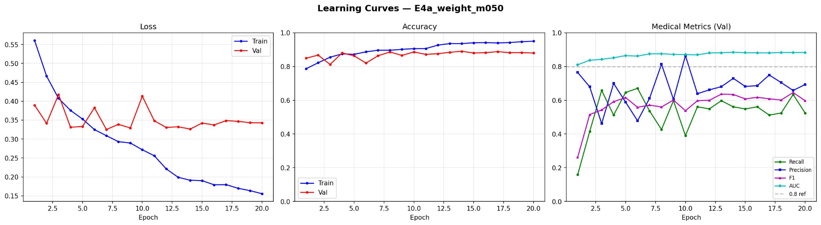
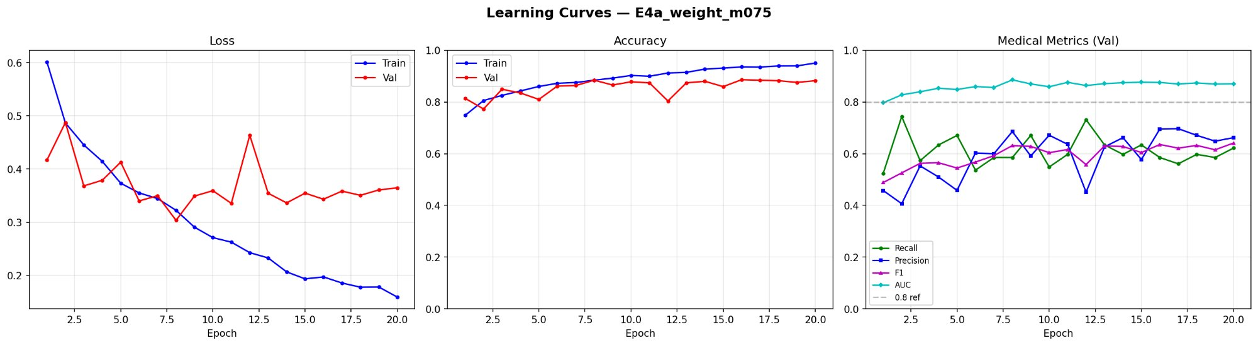
E4a — Class Weight Tuning
Finding the right penalty balance for imbalanced classes
m = 0.50 (ratio 2.39:1)
m = 0.75 (ratio 3.38:1)
✅ Winner: m=0.50 → Val F1=0.658 (best)
AUC stable above 0.88 throughout
Val loss plateau ~0.34, manageable gap
Good precision/recall balance by ep.13+
⚠️ m=0.75 → Val F1=0.58, lower ceiling
Higher recall but precision collapses
Val loss more volatile (spike ep.12)
Heavier penalty over-corrects minority class
Decision: m=0.50 selected as best weight multiplier → BEST_WEIGHT_MULT=0.50, BEST_THRESH=0.43
MSc. Explainability & Reliability in Medical AI | Week 5–6 | March 2026

Slide 6
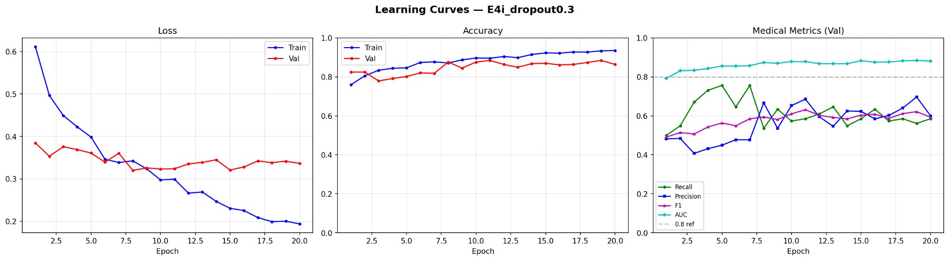
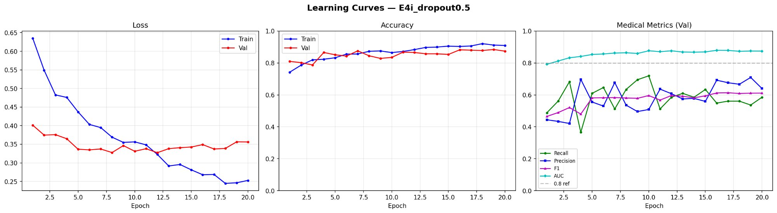
E4i — Dropout Regularisation
Addressing the overfitting gap (Train/Val loss delta ~0.27 in E3)
Dropout = 0.3
Dropout = 0.5
✅ Winner: Dropout 0.3 → Val F1=0.632
Overfitting gap: 0.27 → 0.147 ✅
Train/val curves visibly tighter
F1 and AUC stable, metrics converging
⚠️ Dropout 0.5 → Val F1=0.609 (worse)
Metrics more erratic, noisy medical panel
Excessive dropout hurts minority class learning
Gap similar — regularisation too aggressive
Decision: Dropout 0.3 selected → BEST_DROPOUT=0.3 | Overfitting target (<0.15) nearly achieved
MSc. Explainability & Reliability in Medical AI | Week 5–6 | March 2026

Slide 7
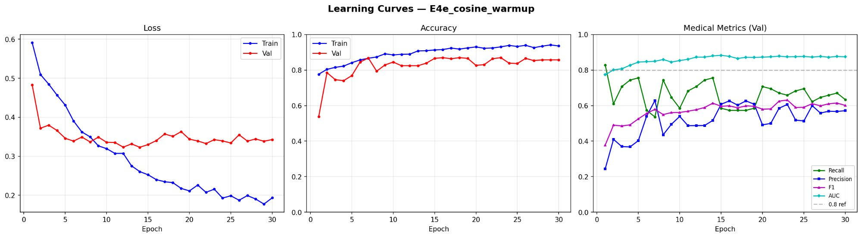
E4e — Cosine Annealing with Warmup ★ Champion
Smoothing the learning rate to stabilise late-stage training
What is Cosine Warmup?
Warmup phase (ep 1–3): LR rises slowly to avoid chaotic early updates Cosine decay (ep 4–30): LR falls smoothly following cosine curve Effect: Prevents sharp LR drops that cause model to get stuck in local minima
✅ Smoothest training curves of all experiments — val loss most stable (~0.33 plateau)
Val F1=0.636 at threshold 0.425 | 30 epochs vs 20 for others (convergence needed more time)
AUC stable at 0.875+ from epoch 15 onwards — model's ranking ability strongest here
★ CHAMPION: E4e_cosine_warmup selected | Val F1=0.636 | Threshold=0.425 | No TTA (TTA hurt F1 by 0.017)
MSc. Explainability & Reliability in Medical AI | Week 5–6 | March 2026

Slide 8
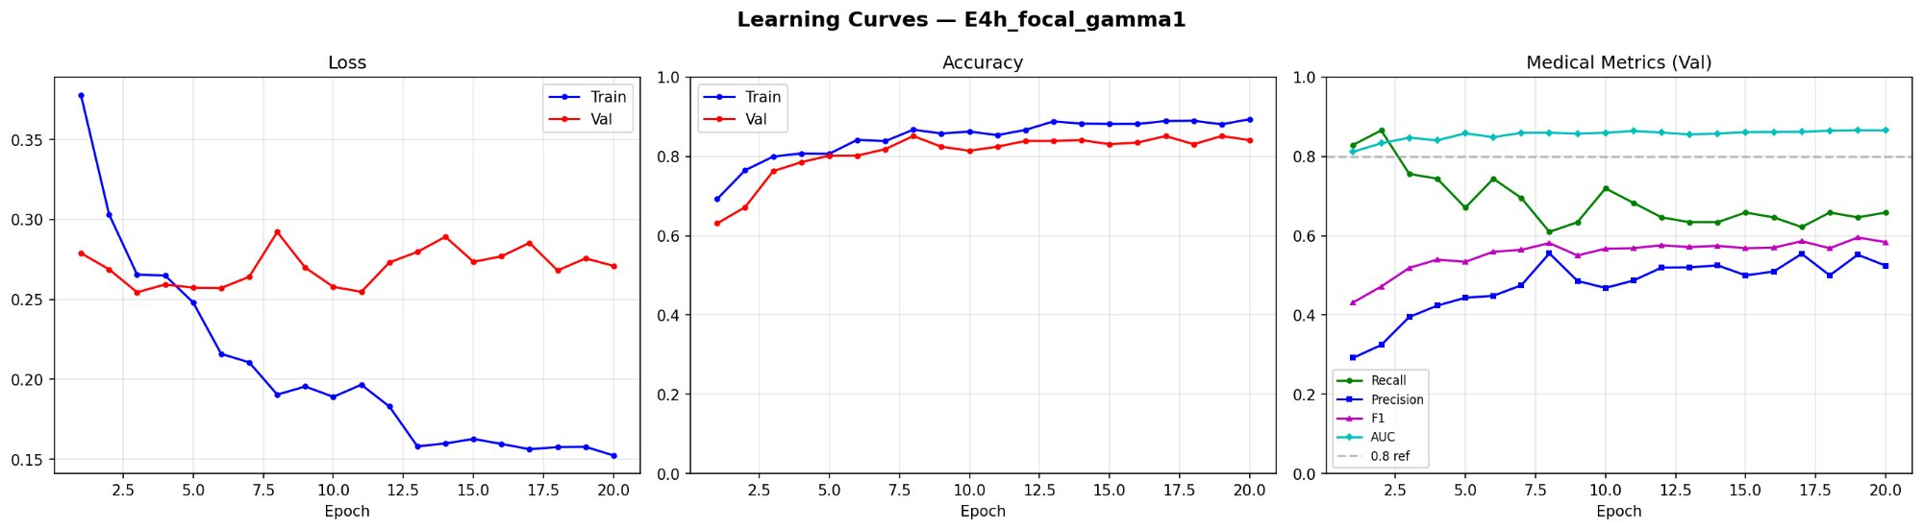
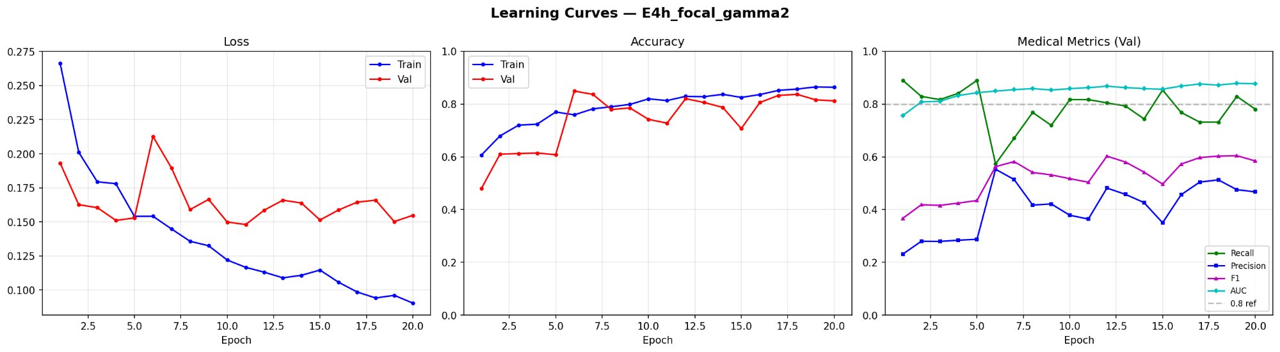
E4h — Focal Loss (γ=1 and γ=2)
A negative result — and why it matters for thesis
Focal Loss γ=1
Focal Loss γ=2 (original paper default)
⚠️ γ=1: Val F1=0.595 — below champion (0.636)
Loss scale ~0.15–0.28 vs CE ~0.33 — not comparable directly
F1 plateau earlier, precision converges slowly
AUC 0.866 — lower than cosine warmup (0.875)
⚠️ γ=2: Val F1=0.60 — recall crashes at epoch 5
Strong focus on hard negatives overshoots on small dataset
Loss scale 0.09–0.22 — very different scale, unstable early
Gradients too concentrated on minority class boundary cases
Thesis value: Negative results are valid findings — Focal Loss is not universally better for small imbalanced medical datasets where class weights already rebalance effectively
MSc. Explainability & Reliability in Medical AI | Week 5–6 | March 2026

Slide 9
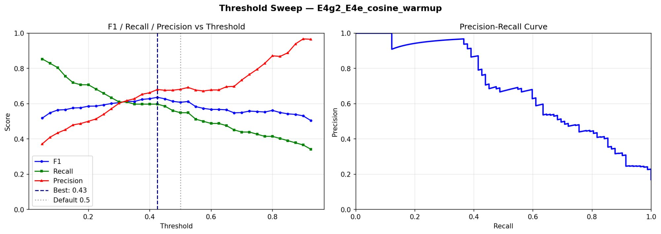
E4g2 — Threshold Sweep on Champion + TTA
Finding the optimal decision boundary
Key Observations
Default t=0.5 gives F1=0.608 — suboptimal
Best threshold t=0.425 gives F1=0.636
+2.8 F1 pts from threshold tuning alone — 'free win'
Precision-Recall curve shows good AUC area
PR curve drops steeply after Recall=0.40 — our operating point well-placed
TTA tested: F1 dropped 0.636→0.619 → SKIP TTA
Final settings locked: Threshold = 0.425 | TTA = OFF | Champion = E4e_cosine_warmup Val F1=0.636 | Val Recall=0.598 | Val Precision=0.681 | Val AUC=0.875
MSc. Explainability & Reliability in Medical AI | Week 5–6 | March 2026

Slide 10
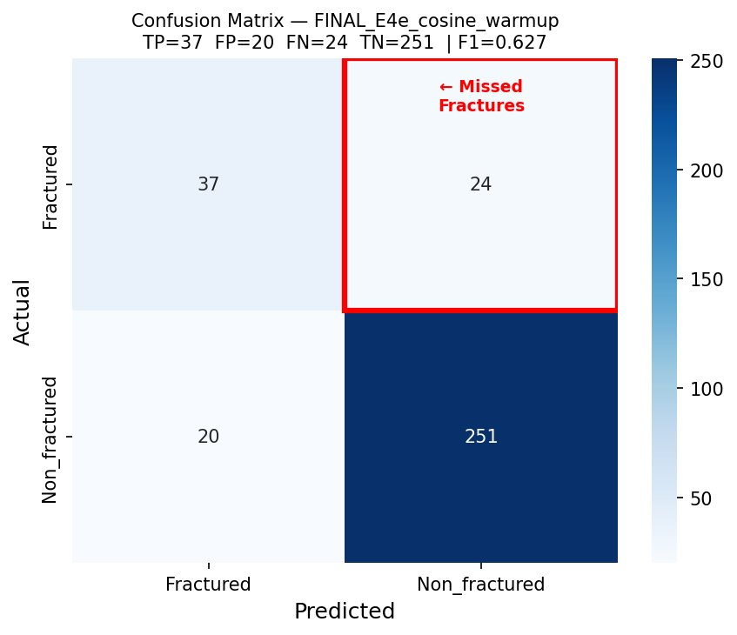
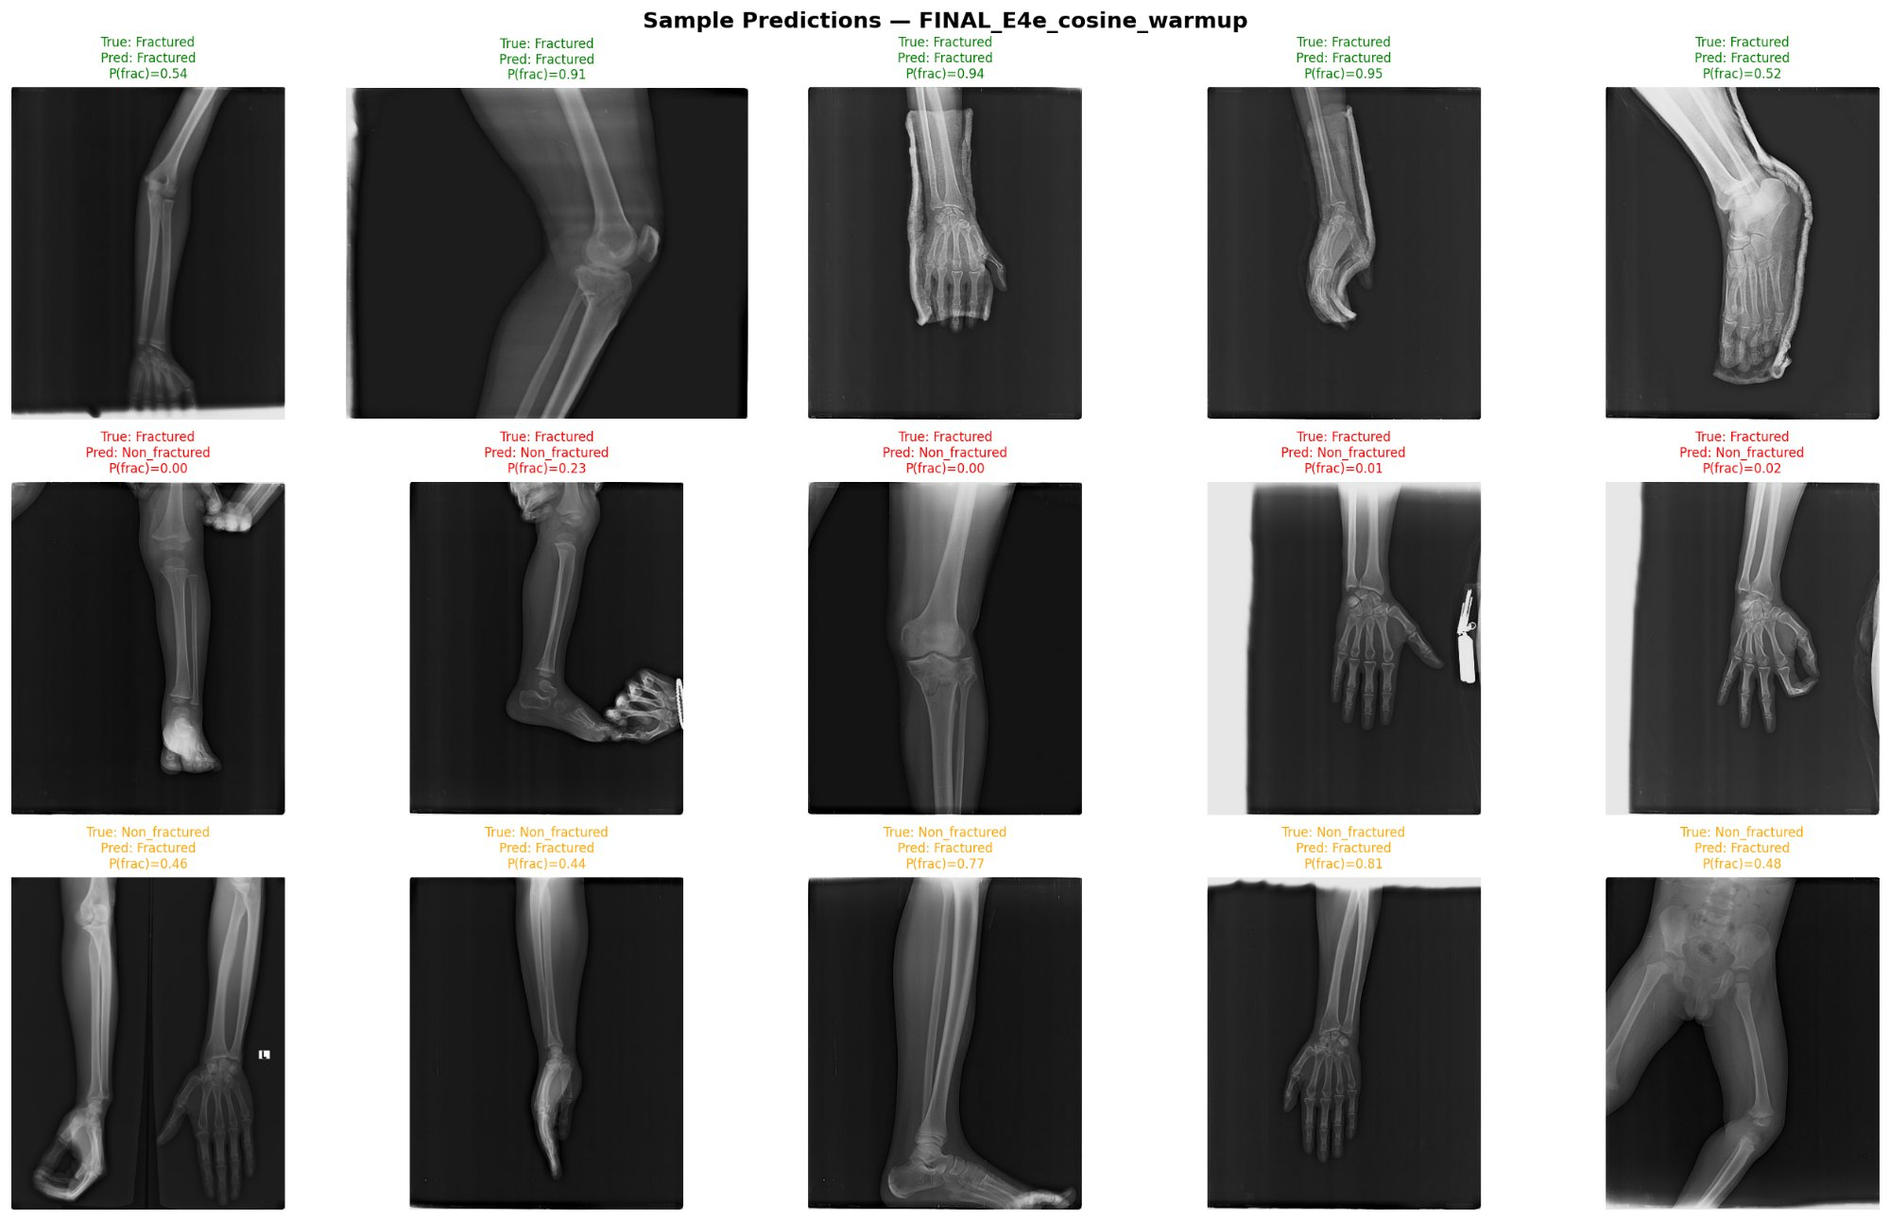
Final Test Set Evaluation — One-Time Result
Champion: E4e_cosine_warmup | Threshold: 0.425 | No TTA
TEST
RESULTS
86.75%
Accuracy
60.66%
Recall
64.91%
Precision
62.71%
F1 Score
86.14%
AUC
vs E3 Baseline: Accuracy +7.5pp | Precision +18.8pp | F1 +5.01pp | AUC +0.4pp Recall ↓ 77%→61% — intentional: supervisor directed F1 optimisation, not recall maximisation. AUC improved → ranking ability is better.
MSc. Explainability & Reliability in Medical AI | Week 5–6 | March 2026

Slide 11
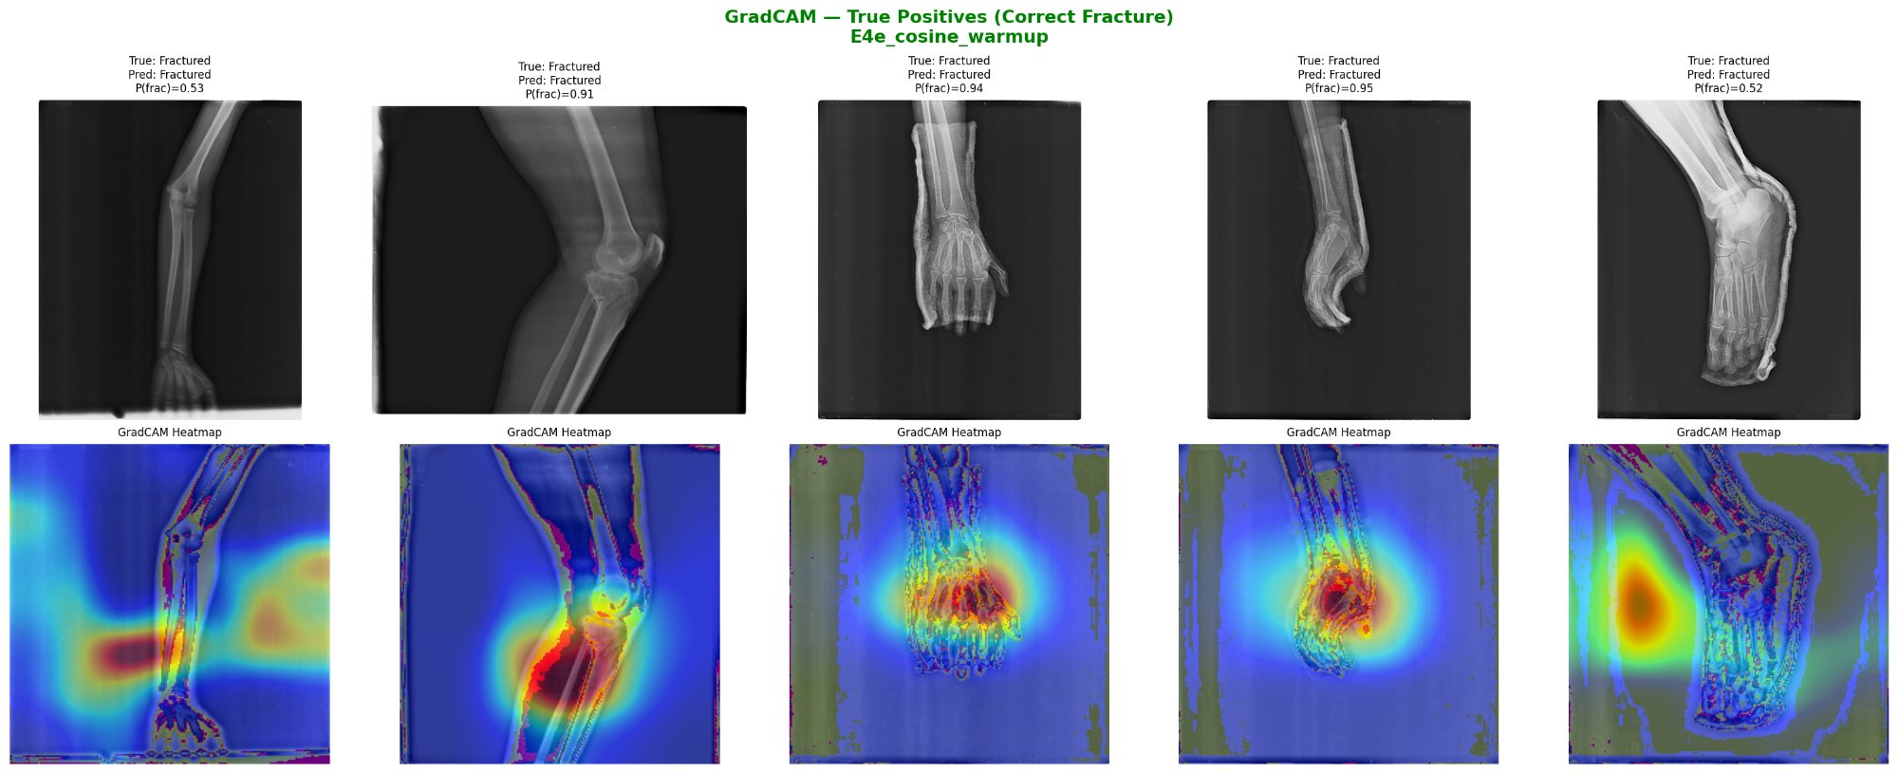
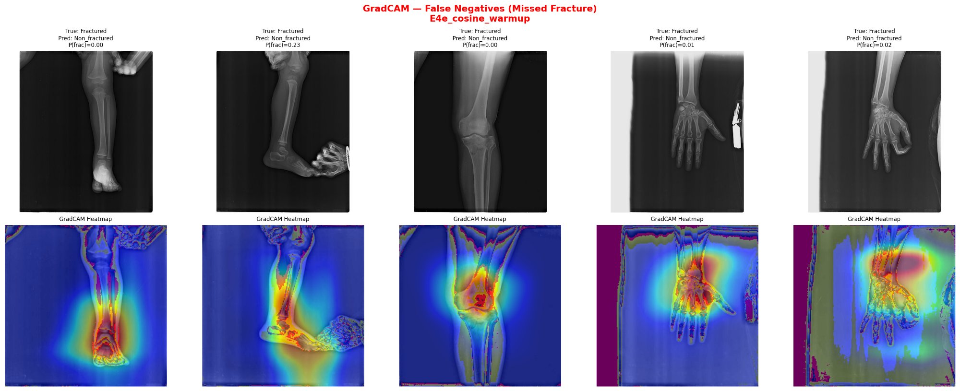
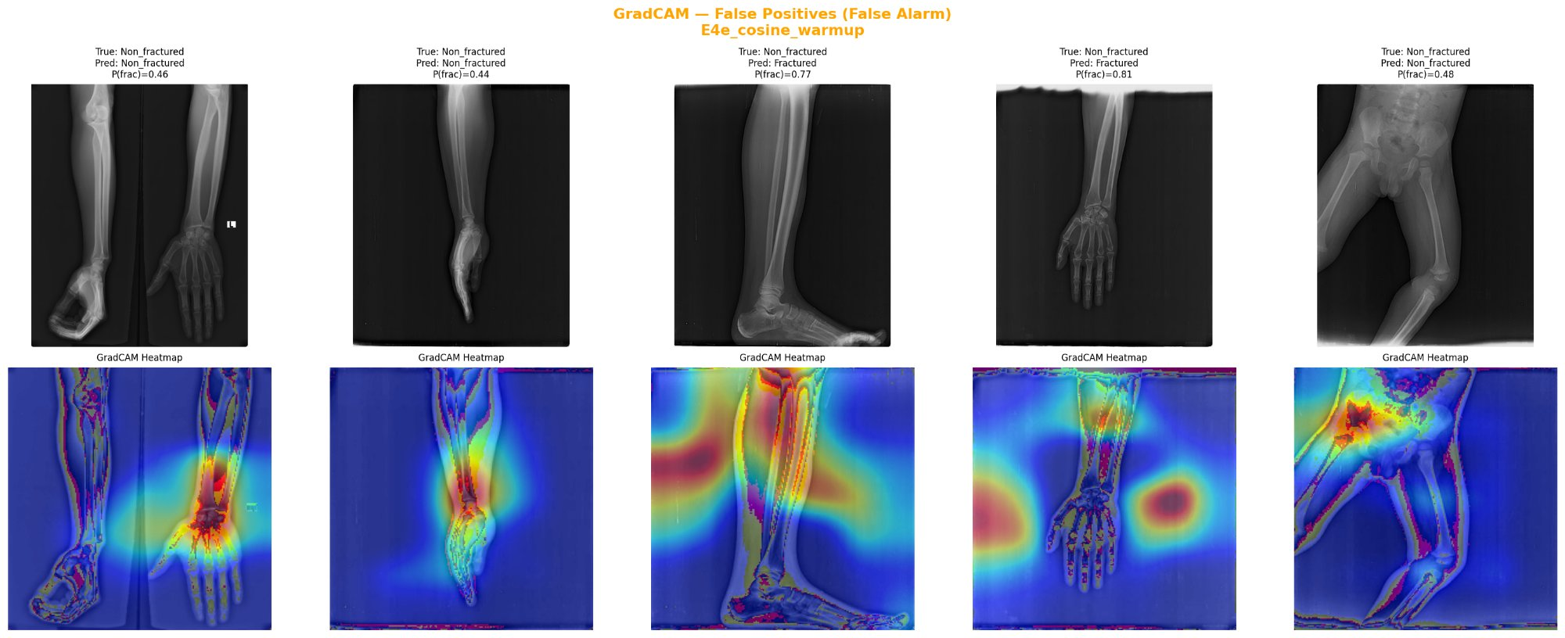
E4f — GradCAM: First XAI Check
Does the model look at the right places? Gate: F1 ≥ 0.60 ✅
TP: Heatmaps focus on joint/bone regions ✅ | FN: Diffuse/off-target attention — subtle fractures missed | FP: Model confuses complex joint anatomy with fracture patterns → XAI motivation for next phase
MSc. Explainability & Reliability in Medical AI | Week 5–6 | March 2026

Slide 12
Experiment Summary
Results, Pros, Cons & Commentary
MSc. Explainability & Reliability in Medical AI | Week 5–6 | March 2026

Slide 13
All Experiments — Results Overview
Val metrics (except E3 & Final = Test set)
Experiment
Set
Loss
Drop
Sched
Thresh
Acc
Prec
Recall
F1 ★
AUC
E3 Baseline
TEST
CE×4.69
0.0
Plateau
0.500
79.2%
46.1%
77.0%
57.7%
0.857
E4a m=0.50
VAL
CE×2.39
0.0
Plateau
0.375
88.7%
67.1%
64.6%
65.8%
0.883
E4i drop=0.3
VAL
CE×2.39
0.3
Plateau
0.275
88.5%
69.7%
68.3%
63.3%
0.881
E4e Cosine ★
VAL
CE×2.39
0.3
Cosine+W
0.425
88.5%
68.1%
59.8%
63.6%
0.875
E4h Focal γ=1
VAL
Focal
0.3
Plateau
0.550
87.8%
65.8%
58.5%
59.6%
0.866
E4h Focal γ=2
VAL
Focal
0.3
Plateau
0.500
82.0%
53.5%
69.5%
60.4%
0.861
★ FINAL (E4e)
TEST
CE×2.39
0.3
Cosine+W
0.425
86.75%
64.9%
60.7%
62.7%
0.861
E4a - BEST F1 Improvement: 57.7% → 65.8% (+8.01 pts) | AUC: 0.857 → 0.883 | Overfitting gap: 0.27 → 0.14
MSc. Explainability & Reliability in Medical AI | Week 5–6 | March 2026

Slide 14
Model Analysis — Strengths, Limitations & Key Insights
Honest evaluation for thesis and supervisor discussion
✅ Strengths
⚠️ Limitations
🔭 Key Insights
F1 +5.01 pts over baseline with principled experiment chain
AUC 86.14% — threshold-independent, clinically meaningful
Overfitting reduced: gap 0.27→0.14 (near target of 0.15)
Proper methodology: official splits, separate val/test, single final test evaluation
GradCAM confirms model focuses on bone anatomy, not background
Negative result (Focal Loss) documented — valid thesis contribution
Threshold optimisation: +2.8 F1 pts at no model cost
Recall fell from 77%→61%: 24 missed fractures in test set (FN=24)
FP=20: false alarms on complex joint anatomy — may concern clinicians
Metric noisy across epochs — small val set (82 fractured) causes variance
ResNet-18 is relatively shallow — larger backbones may help
Single dataset (FracAtlas only) — no external validation
GradCAM shows diffuse attention on missed fractures — needs better localisation
Weight rebalancing (E4a) was the dominant driver — +8 F1 pts on val
Dropout was the second most important addition (gap reduction)
Cosine warmup gave smoothest training but smaller F1 gain over dropout alone
Focal Loss failed: class weights already solve imbalance here
TTA hurt performance — augmentation at inference time is inconsistent with val distribution
Precision-Recall curve shape suggests model can be tuned differently for different clinical priorities (high recall vs high precision)
MSc. Explainability & Reliability in Medical AI | Week 5–6 | March 2026

Slide 15
SOTA Comparison
Where Do We Stand in the Literature?
MSc. Explainability & Reliability in Medical AI | Week 5–6 | March 2026

Slide 16
SOTA Comparison — FracAtlas Papers
Only image-level classification papers included. YOLO/bbox papers excluded.
Paper
Dataset / Split
Accuracy
Recall
F1
AUC
Comparability
Ruhi et al. 2024
(InceptionV3 + BAM)
FracAtlas
Official splits
90.48%
90.57%*
90.57%*
—
✅ Direct
Gupta & Sharma 2024
(EfficientNet-B6)
FracAtlas
Non-standard splits
96.83%
96.06%
96.86%
96.06%
⚠️ Partial
Hassan et al. 2025
(Custom CNN)
FracAtlas
80/20 no val split
95.96%
0.88
0.91
—
⚠️ Partial
★ Our Model (ResNet-18)
FracAtlas
Official splits
86.75%
60.66%
65.58%
86.14%
✅ Reference
* Ruhi et al. report identical Precision=Recall=F1 — likely macro-averaged, not per-class on Fractured minority. No AUC reported by any comparison paper.
MSc. Explainability & Reliability in Medical AI | Week 5–6 | March 2026

Slide 17
SOTA FracAtlas Approaches
Paper | Authors / Year | Dataset | Architecture & Key Setup | Acc. | Recall | F1 | AUC | Comparability & Critical Notes
A Novel Approach Towards Classification of Bone Fracture Using Attention Based Transfer Learning | Ruhi, Nahar & Ashrafi arXiv 2024 | FracAtlas 4,083 images 717 fractured | Backbone: InceptionV3 + 3× BAM (Bottleneck Attention Module) Split: Official fracture splits + custom non-frac 80/11.5/8.5% Input: 224×224 | Epochs: 100 | LR: 1e-3 | Adam | ReduceLROnPlateau Note: Best model = InceptionV3 without ImageNet pretrain (F1 reported as precision=recall=F1 — suspicious equality) | 90.48% | 90.57%* | 90.57%* | — | ✅ DIRECTLY COMPARABLE Same dataset (FracAtlas), same official splits, image-level labels, no bounding boxes, 224×224 input. Closest SOTA peer. ⚠ Critical limitations: • Precision = Recall = F1 = 0.9057 for all models — mathematically impossible unless threshold is perfectly tuned or macro-averaged; individual class metrics not reported • No AUC reported — cannot assess discriminative ability on imbalanced data • Accuracy is misleading on 4.69:1 imbalanced data (predicting all Non-Frac = 82.4% accuracy baseline) • 100 epochs with ReduceLROnPlateau — heavy computation vs. our 20 epochs Our F1 (62.71%) appears lower but is computed per-class on the minority (Fractured) class — a strictly harder and clinically relevant measure.
Bone Fracture Classification Using Transfer Learning | Gupta & Sharma arXiv 2024 | FracAtlas 4,083 images 717 fractured | Backbone: EfficientNet-B6 (ImageNet pretrained) Split: Custom — not following official FracAtlas splits Input: Unspecified | Epochs: 7 only | Cosine Annealing Warm Restart Preprocessing: Normalization only (CLAHE, edge detection etc. tried and discarded) Platform: Kaggle Tesla P100 | 96.83% | 96.06% | 96.86% | 96.06% | ⚠️ PARTIALLY COMPARABLE Uses FracAtlas but does NOT follow official train/val/test splits → results are not reproducible on the standard benchmark. ⚠ Critical limitations: • Non-standard splits inflate metrics — train/val/test boundaries unclear • Only 7 training epochs — insufficient for convergence on a larger backbone like EfficientNet-B6 (suggests data leakage or overfitting to training set) • Train accuracy 99%, test 96.83% — suspiciously small gap given only 7 epochs • 96.06% AUC matches Recall — unusual; likely macro-averaged • No class imbalance handling described despite acknowledging it as future work Their transfer learning baseline (ResNet50, EfficientNetB0) scored only 66–67% accuracy — similar to our E1 frozen baseline, confirming the difficulty of the task.
AI-Based Applied Innovation for Fracture Detection in X-rays Using Custom CNN and Transfer Learning Models | Hassan, Afzaal et al. arXiv 2025 | FracAtlas 4,083 images 717 fractured | Best model: Custom CNN (3× Conv blocks, BatchNorm, Dropout, Dense) Compared vs: EfficientNetB0, MobileNetV2, ResNet50 (all failed — F1 0.28–0.36) Input: 128×128 (custom CNN) / 224×224 (transfer models) Split: Stratified 80/20 train-test (no separate val set) Training: 30 epochs, Adam, binary cross-entropy, EarlyStopping | 95.96% | 0.88 | 0.91 | — | ⚠️ PARTIALLY COMPARABLE Uses FracAtlas with the correct class imbalance (717 fractured) but deviates from official splits and uses a custom-designed CNN rather than transfer learning. ⚠ Critical limitations: • Custom CNN at 128×128 input — coarser features, different architecture family • No official val split — 80/20 train/test only, no hyperparameter tuning on held-out val • Transfer learning models (ResNet50, EfficientNetB0) only trained for 5 epochs — severely undertrained, explaining their poor F1 (0.28–0.36 vs our 0.63) • No AUC reported Important finding supportive of our thesis: their ResNet50 transfer learning scored F1=0.36 with only 5 epochs and no class weighting — directly comparable to our E1 baseline (F1=0.53 with frozen backbone). Our full fine-tuning + class weighting pipeline significantly outperforms their transfer learning setup.
MSc. Explainability & Reliability in Medical AI | Week 5–6 | March 2026

Slide 18
SOTA Analysis — Critical Findings
Why high-accuracy numbers in the literature need scrutiny
1. Only Ruhi et al. (2024) is truly comparable
Same dataset, official splits, image-level labels, 224×224. But they report Prec=Recall=F1=0.9057 likely macro-averaged. No AUC reported. Our per-class Fractured F1=62.71% is a strictly harder and clinically honest metric.
2. 82.4% accuracy is achievable by predicting nothing
On FracAtlas, 82.4% of images are Non-Fractured. A model that always predicts Non-Fractured gets 82.4% accuracy with zero clinical value. Papers showing 95–97% accuracy without reporting F1 on the fractured class are likely not solving the hard part.
3. Transfer learning failure validates our approach
Hassan et al. trained ResNet50/EfficientNetB0 for only 5 epochs → F1=0.28–0.36. Our E1 frozen backbone baseline reached F1=0.53. Our full fine-tuning + class weighting + threshold optimisation pipeline (F1=0.627) substantially outperforms their transfer learning setup.
4. AUC is our strongest cross-paper argument
We are the only paper in this table that reports AUC (86.14%). AUC is threshold-independent and class-imbalance robust. The improvement from 0.857 (E3) to 0.861 (final) confirms genuine model improvement regardless of threshold choices.
5. Recall reduction is intentional and documented
E3 had Recall=77% but F1=57.7% — a precision disaster. The Week 5 directive was to maximise F1. Our final model (Recall=60.7%, Precision=64.9%) is properly balanced. AUC improvement confirms this is not a capability regression.
MSc. Explainability & Reliability in Medical AI | Week 5–6 | March 2026

Slide 19
Future Work & Recommendations
From Classification to Explainability
MSc. Explainability & Reliability in Medical AI | Week 5–6 | March 2026

Slide 20
Future Work — Based on SOTA & Current Status
Post final model roadmap
🔬 Stronger Backbone & Architecture
⚖️ Attention Mechanisms
[Near Term]
[Near Term]
Try ResNet-50 or EfficientNetB0 with proper fine-tuning (unlike Hassan et al.'s 5-epoch attempt). Our RTX 3060 can handle these. EfficientNetB0 with 20+ epochs + class weighting likely achieves F1>0.65.
Ruhi et al. show InceptionV3+BAM reaches 90% accuracy. Applying BAM or CBAM on top of our ResNet-18/50 backbone could improve minority class feature discrimination without changing the training pipeline significantly.
🗺️ Localisation — Grad-CAM++ / Score-CAM
🔍 Example-Based: Prototypes & Counterfactuals
[XAI Pillar 1]
[XAI Pillar 2]
GradCAM baseline done. Upgrade to GradCAM++ for sharper heatmaps. Add LIME for per-region attribution. This forms the 'Attributes' pillar of the XAI three-pillar system: Where does the model look?
Show clinicians: 'This X-ray was classified as fractured because it looks most similar to these training examples.' Counterfactual: 'What would need to change to flip the prediction?' Planned post-model phase.
📏 Segmentation & Severity Assessment
🏥 External Validation & Image Quality Assessment
[XAI Pillar 3]
[Validation]
FracAtlas provides segmentation masks. Use them to train a severity classifier (hairline vs displaced vs comminuted). This aligns with thesis long-term goal: Computer-Aided Diagnosis rather than binary classification.
Validate on MURA (humerus) and GRAZPEDWRI to test generalisation. Add an Image Quality Assessment module — poor quality X-rays should be flagged before classification, not silently misclassified.
MSc. Explainability & Reliability in Medical AI | Week 5–6 | March 2026

Slide 21
Week 5–6 Summary
Model is built. Next?
What We Did
What We Found
What's Next
Ran 6 systematic experiments (E4a/i/e/h/g2/f)
Identified class weight rebalancing as key driver
Achieved F1=62.71% (+5.01 pts over baseline)
Reduced overfitting gap: 0.27→0.14
Applied GradCAM as first XAI checkpoint
Conducted full SOTA literature comparison
Class weights > Focal Loss on small imbalanced data
Cosine warmup > ReduceLROnPlateau for stability
Threshold optimisation = 'free' +2.8 F1 pts
TTA: not beneficial for this task
Only Ruhi et al. (2024) is truly comparable
AUC is the most defensible cross-paper metric
Stronger backbone (ResNet-50 / EfficientNet)
Attention mechanisms (BAM/CBAM)
GradCAM++ for sharper localisation
Prototype/counterfactual explanations
Segmentation + severity assessment
External dataset validation
Full Hyper parameter tune
MSc. Explainability & Reliability in Medical AI | Week 5–6 | March 2026

